Slide 1

SURFACE CRACK DETECTION USING SUPERVISED LEARNIING method Presented by Rajashri chitti

Slide 2
CONTENT
Introduction
Motivation
Objective
Literature review
Methodology used in base paper
Implementation
Conclusion

Slide 3
INTRODUCTION
Crack classification is an approach to find the specific crack type using machine learning algorithms.
Crack detection identifies or recognizes the presence of crack whereas crack classification classifies the crack based on the feature extracted from the crack region.
Crack detection plays a major role in the building inspection, finding the cracks and determining the building health.
CNN model is used in crack detection.

Slide 4
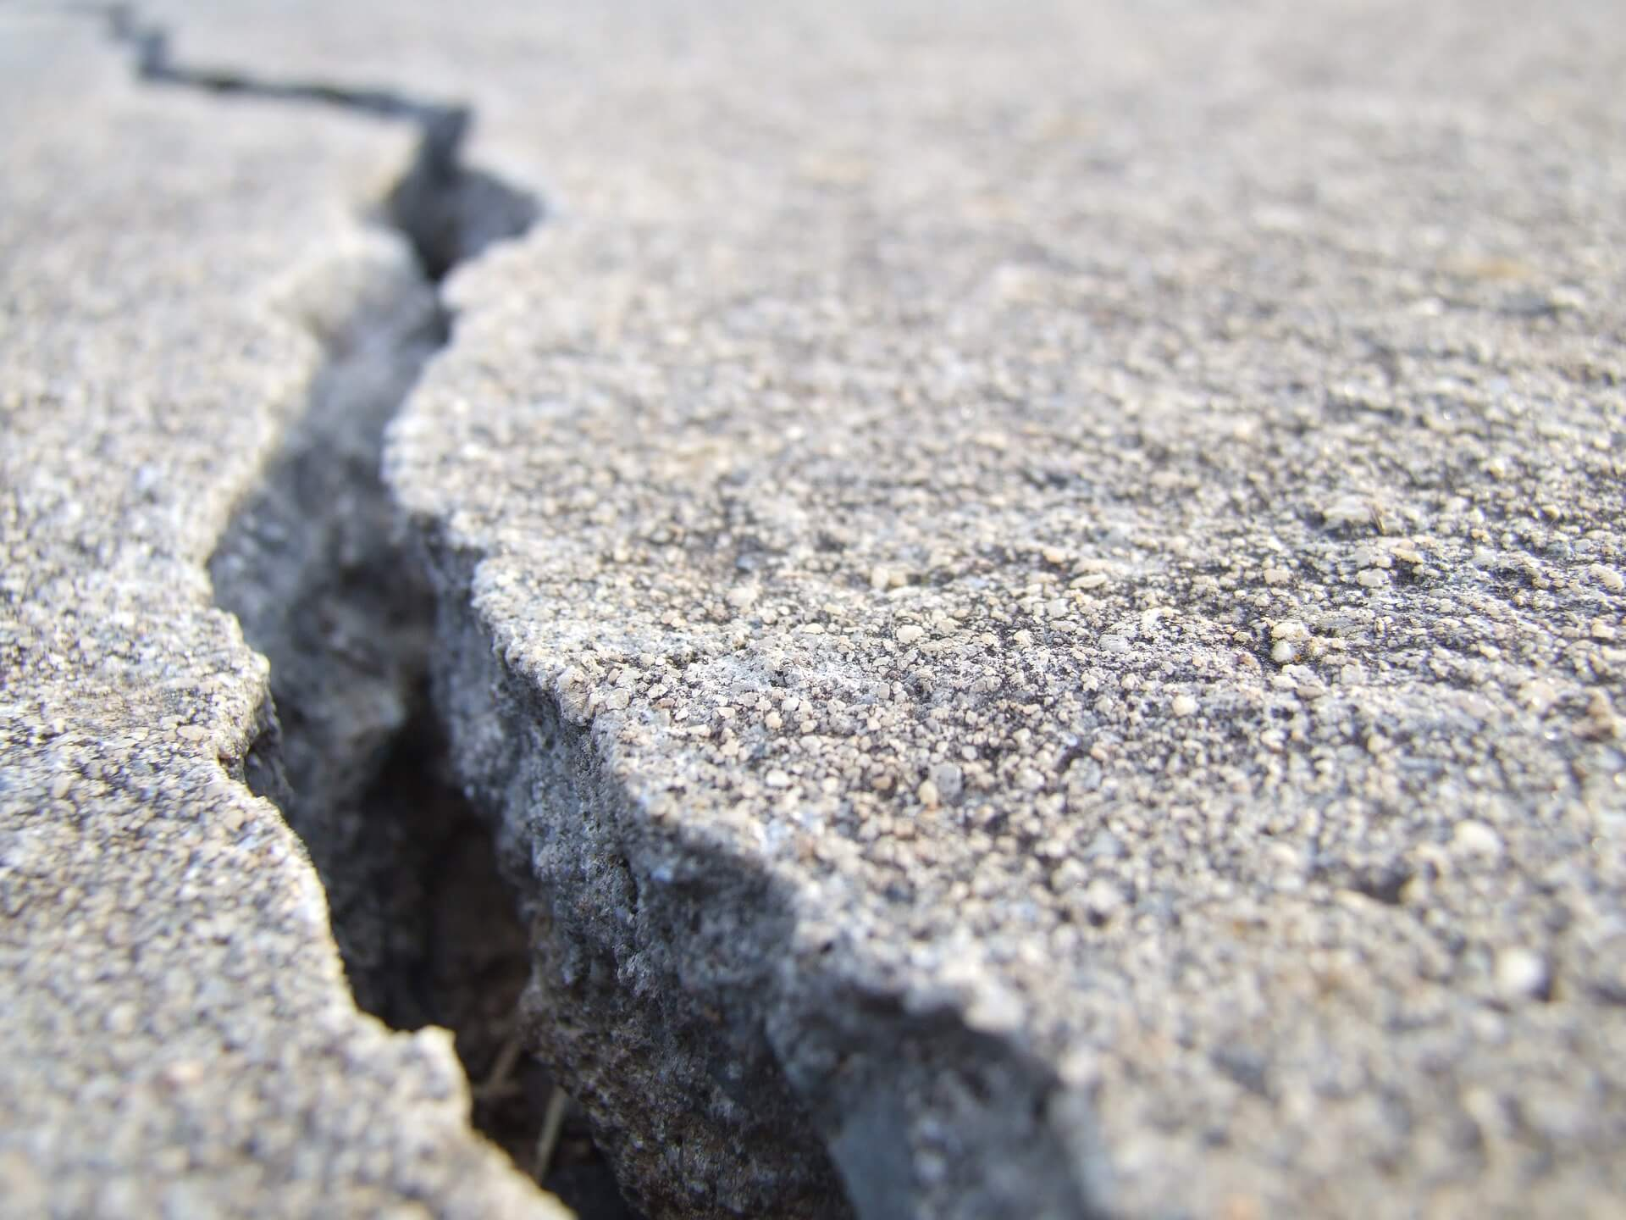
Motivation
Cracks are very common in building, bridge, road, pavement, railway track, automobile, tunnel and aircraft. The presence of crack diminishes the value of the civil infrastructure and hence it is necessary to detect it.
Crack detection and classification techniques with quantitative analysis play a major role in finding the severity of crack.

Slide 5
Objective
To study different supervised methods for crack detection.
To detect and classify the cracks on the surface into binary classes based on image processing by using supervised learning method.

Slide 6
Literature RIVIEW
No | Title | Features | Limitation | Future work
1 | Road crack detection and classification using deep learning method, IRJET 2021, Harshal Bhoir, Amitkumar Pandey, Rushikesh Patil, Aparna Bhonde | YOLO Input through camera Report is generated for the output file | Limited dataset is used | Accuracy can be improved
2 | Concrete crack detection based on well known feature extraction model and YOLOv2 network, Applied science, 2021, Shuai Teng, Zongchao Liu, Gongfa Chen, Li Cheng | CNN model, YOLOv2, Precision 0.89 | Limited dataset is used | Accuracy can be improved
3 | Road crack detection using CNN, Indian journal of science and technology, 2021, Sharmad Bhat, Saish Naik, Mandar Gaonkar, Pradnya Sawant, Shailendra Aswale, Pratiksha Shetgaonkar | CNN classifier 0.99 accuracy | Limited dataset is used(300MB) | Large dataset can be tested

Slide 7
4 | An integrated ML model for automatic road crack detection and classification in urban areas, International Journal of Pavement Engineering 2021, Abbas Ahmadi, Sadjad Khalesi & Amir Golroo | Integrated model, image segmentation heuristic algorithm, Hough transform technique, heuristic equation hybrid model 93.86% Accuracy | Severity level is not calculated | Develop app, severity measurement
5 | Building crack due to Lombok Earthquake classification based on GLCM feature and SVM classifier, Intelligent Manufacture and Industrial Automation (ICAMIMIA) 2019, Gede Pasek Suta Wijaya, Chaerus Sulton, Ida Bagus Ketut Widiartha, Ni Nyoman Kencanawati | Classified crack into mild, moderate and severe categories using GLCM features and SVM classifier, accuracy 81.48%, recall 81.41%, precision 88.09% | Tested on small dataset | Alternative strategy can be developed to improve performance
6 | Deep convolutional neural network for crack detection on asphalt pavement, ICoNSET 2019, IOP, N A M Yusof, A Ibrahim, M H M Noor, N M Tahir, N M Yusof and N Z Abidin, M K Osman | DCNN architecture is used and achieved an accuracy of 94.5% Identified traverse longitudinal and alligator crack | Problems with noisy background | Pixel algorithm can be improved to classify different type of crack

Slide 8
7 | Road crack detection using deep CNN and adaptive thresholding, IEEE 2019, Rui Fan, Mohammud Junaid Bocus, Yilong Zhu, Jianhao Jiao1, Li Wang, Fulong Ma, Shanshan Cheng, Ming Liu1 | Adaptive image segmentation is used and 99.95% accuracy is achieved | Some noisy images can’t be properly segmented | DNN can be trained to segmentation of semantically meaningful region
8 | Feature pyramid and hierarchical boosting network for pavement crack detection, IEEE 2019, Fan Yang, Lei Zhang, Sijia Yu, Danil Prokhorov, Xue Mei, and Haibin Ling | FPHBN Network for crack detection | restricted computation resource limited no of images for crack dataset | Speed can be improved
9 | Sample and structured guided Network for road crack detection, IEEE 2019, Siyuan Wu, Jie Fang, Xiangtao Zheng, Zijie Li | Self attention strategy, presents sample and structure guided network | Photographed images are not labelled | algorithm generalized to open dataset
10 | Review and analysis of crack detection and classification techniques based on crack types, International journal of applied engineering and research, 2018, Sheerin Sitara, N. Kavita, S. Raghuraman G. | survey on different cracks, image enhancement using wavelet transformer and singular value decomposition for easy identification |  | Result has to be analyzed using appropriate quantitative metrics

Slide 9
11 | Automatic pavement crack detection based on structured prediction with CNN, IEEE 2018, Zhun Fan, Yuming Wu, Jiewei Lu, and Wenji Li | Supervised method CNN is used for classification | Limited sample of patches available in images | Images which have more no of crack images in the dataset.
12 | Road crack detection using single stage detector based DNN, 2018 IEEE Workshop on Environmental, Energy, and Structural Monitoring Systems (EESMS), Carr, Thomas Arthur; Jenkins, Mark David; Iglesias, Maria Insa; Buggy, Tom; Morison, Gordon | feedforward ResNet architecture | Trained with limited dataset | Large dataset can be tested
13 | Automated road crack detection using CNN, 2018 IEEE International Conference on Big Data (Big Data), Vishal Mandal, Lan Uong, Yaw Adu-Gyamfi | YOLO v2, CNN for distress analysis, pre trained Microsoft COCO dataset | Accurate in evaluating alligator crack but not with traverse crack | Google street images can be taken for crack information

Slide 10
14 | Fully automated road defect detection using street view image, 14th conference on computer and robot vision, 2017 | Identified distressed road from street view images, predicting distress region by computing fisher vectors on local SIFT, contour weights to predict severity, 93% accuracy and precision | Classifier trained on KIIT dataset did not generalized well | It can be trained and tested on PCI data
15 | Road crack detection using deep CNN, IEEE 2016, Lei Zhang, Fan Yang, Yimin Daniel Zhang, and Ying Julie Zhu | Supervised DNN and YOLO2 model is used | Model is not accurate | Crack can be detected in real time.

Slide 11
Base Paper
Road crack detection using CNN, Indian journal of science and technology, 2021, Sharmad Bhat, Saish Naik, Mandar Gaonkar, Pradnya Sawant, Shailendra Aswale, Pratiksha Shetgaonkar

Slide 12
Details
CNN Architecture is used to detect the crack and the type of crack and it focuses on studying and comparing different methods used in crack detection.
Model is then compared with the existing models in the same domain. The models used in comparison are ResNet, VGG 16 and VGG 19.
ResNet model has achieved highest accuracy 98.91%.
Datasets used by collecting from two different sources. The first dataset contains a set of around. 4000 images, out of which 2000 images are cracked and 2000 images are non-cracked. The size of this dataset was around 300mb.

Slide 13
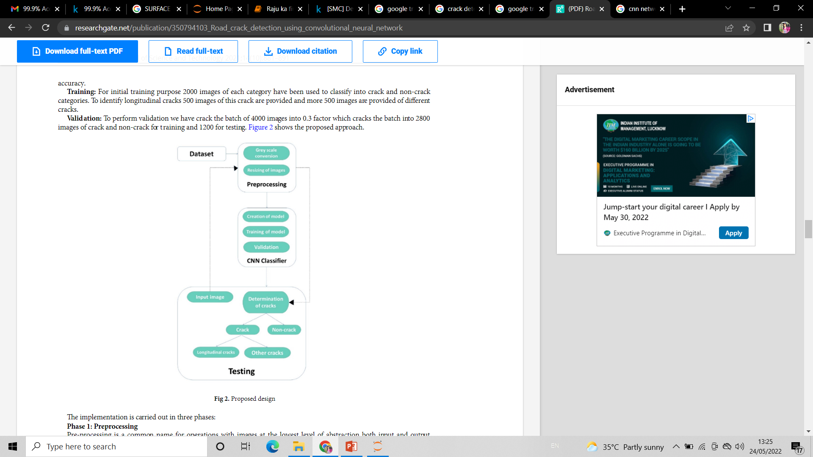
METHODOLOGY USED in base paper
3

Slide 14
Implementation

Slide 15
Dataset details
This dataset is taken from the website Mendeley Data - Crack Detection.
The datasets contains images of various concrete surfaces with and without crack.
The image data are divided into two as negative (without crack) and positive (with crack) in separate folder for image classification. Each class has 20000images with a total of 40000 images with 227 x 227 pixels with RGB channels.

Slide 16
Methodology followed
Pre-processing
RGB to Gray scale conversion
Creation of model
Determination of crack
CNN Classifier
Training
Validation

Slide 17
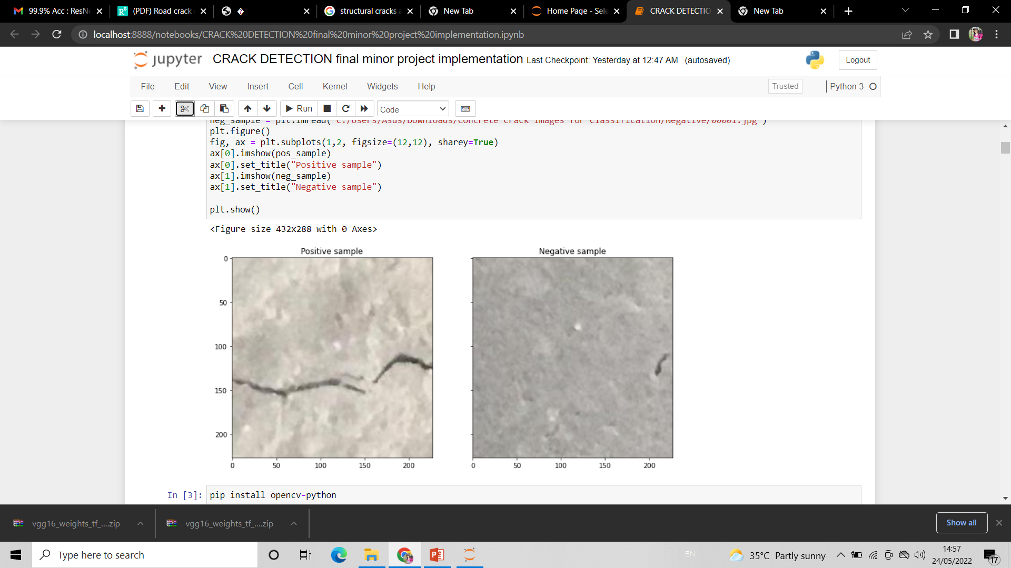
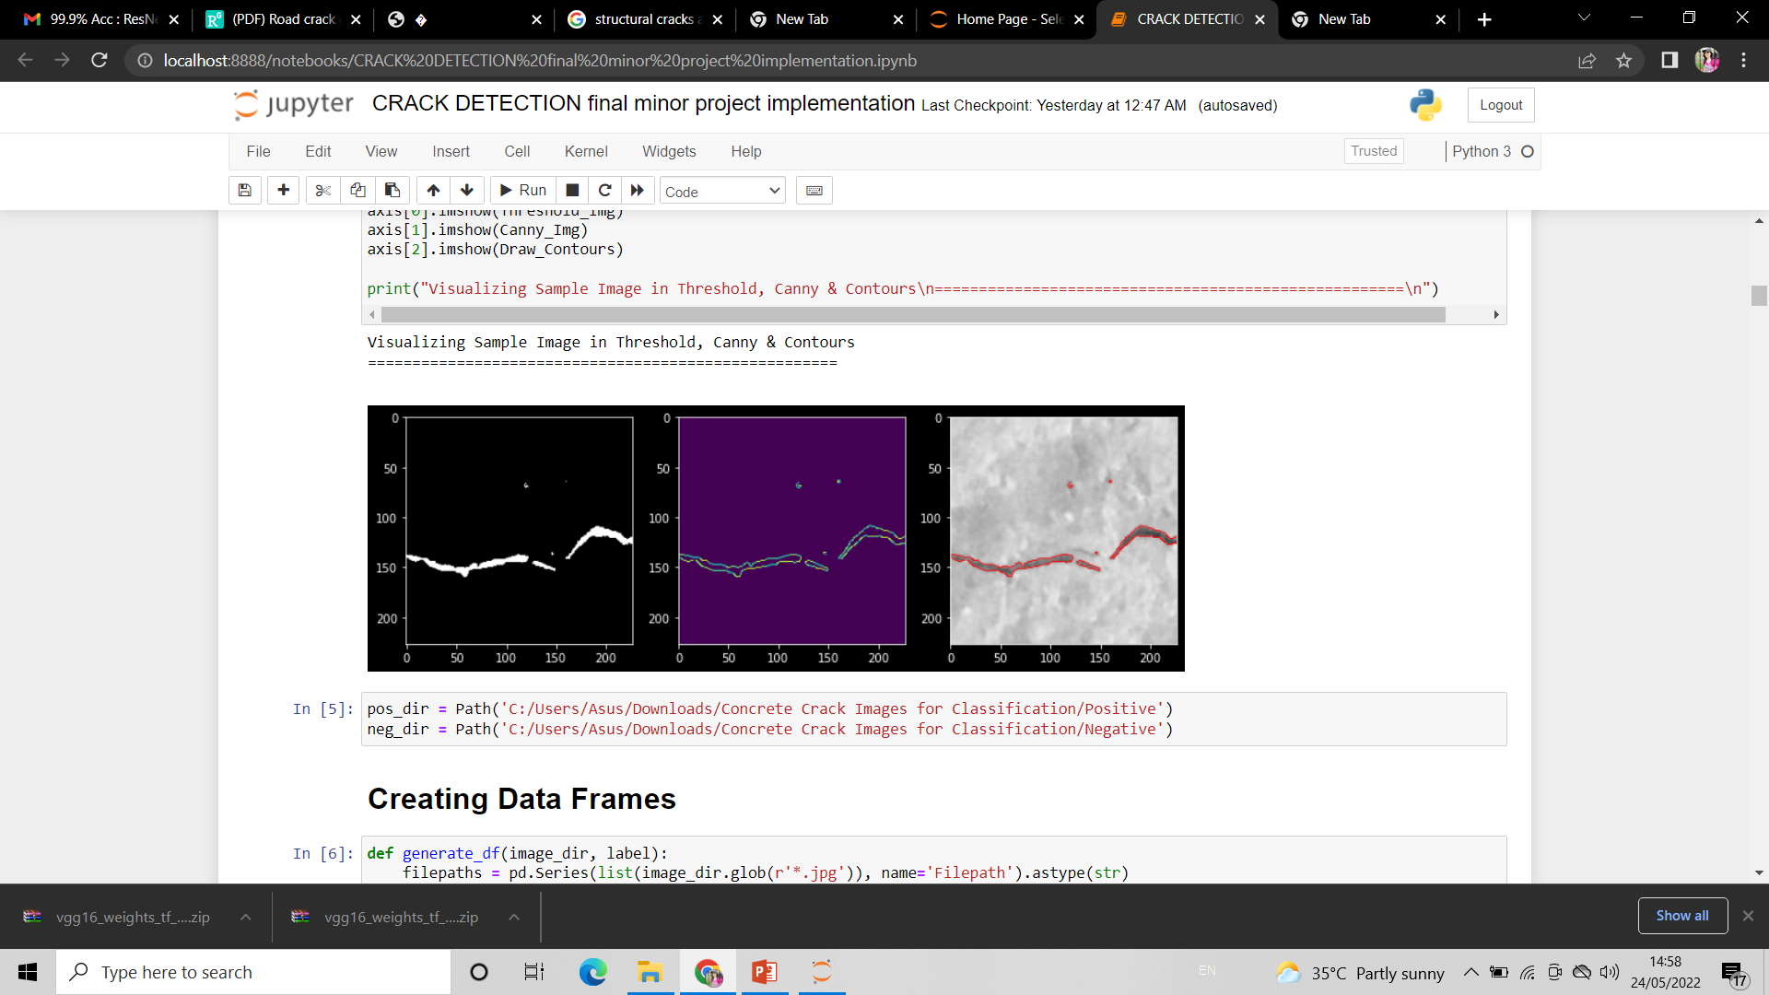
Screenshots

Slide 18
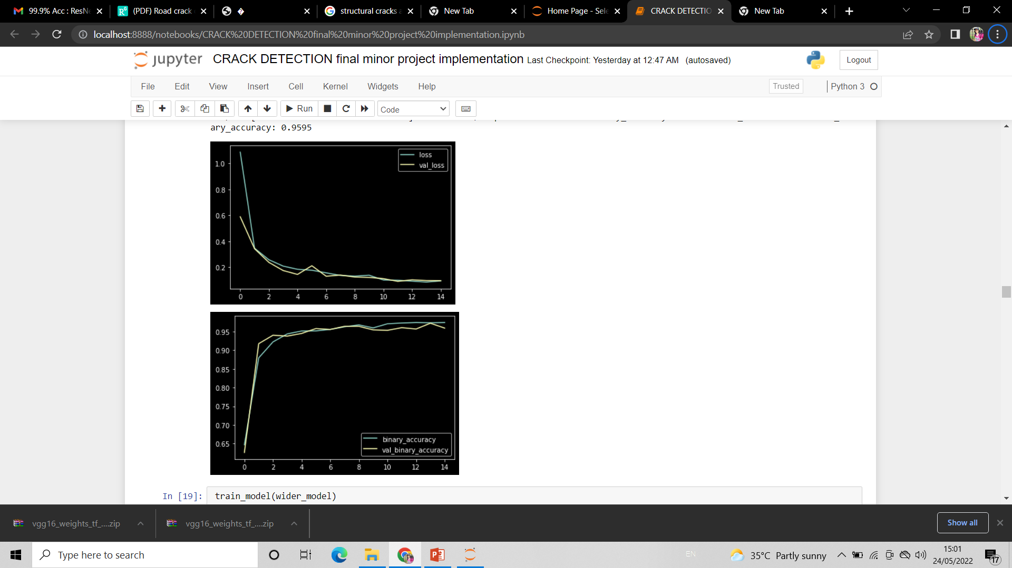
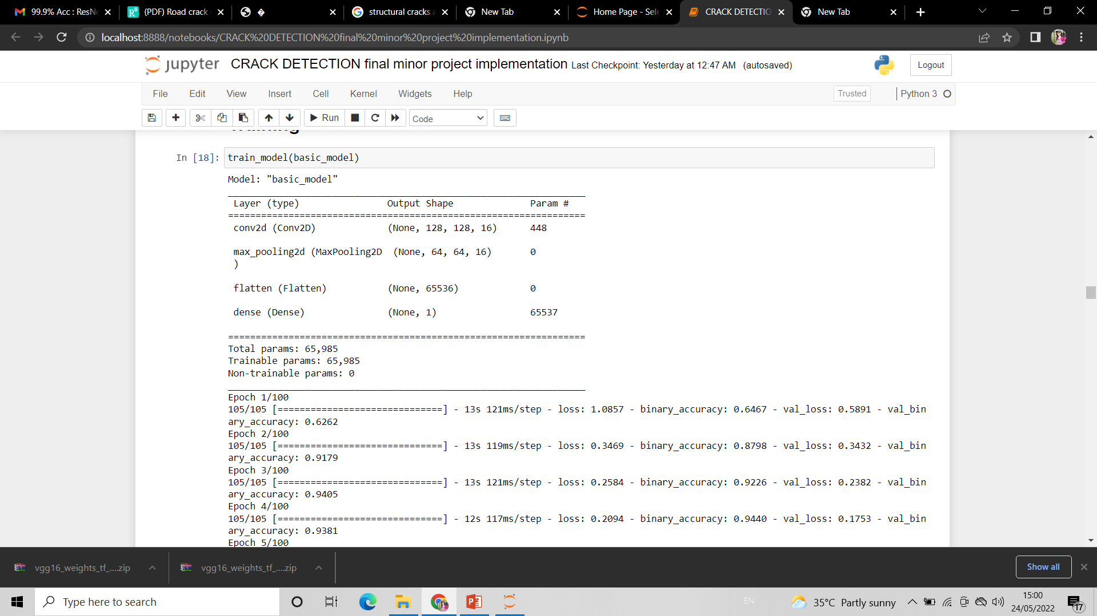
Basic model

Slide 19
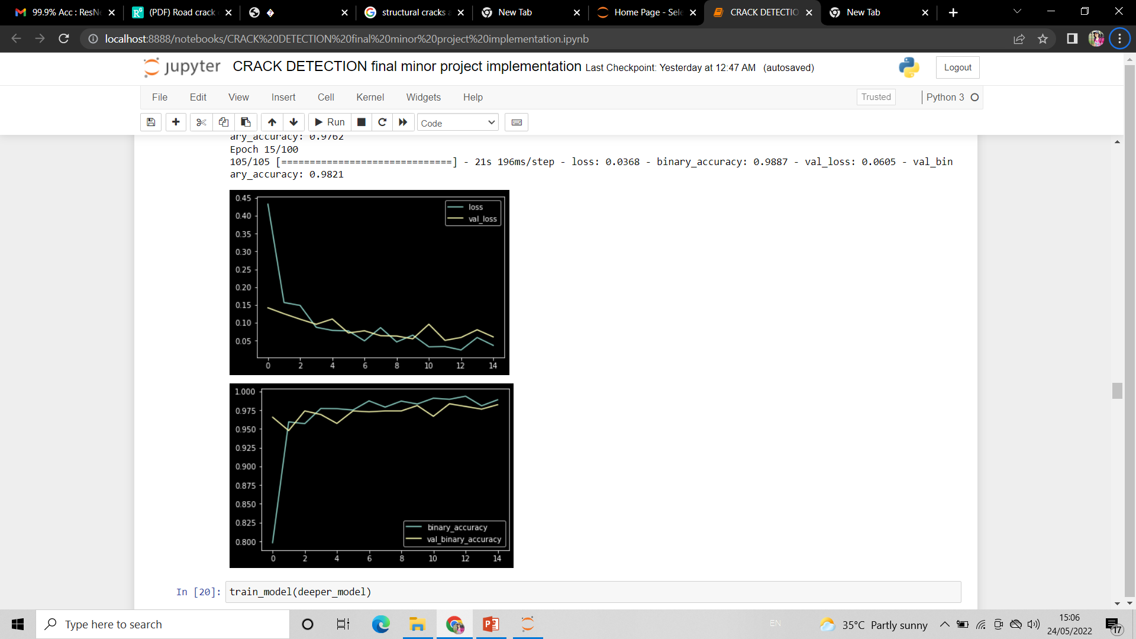
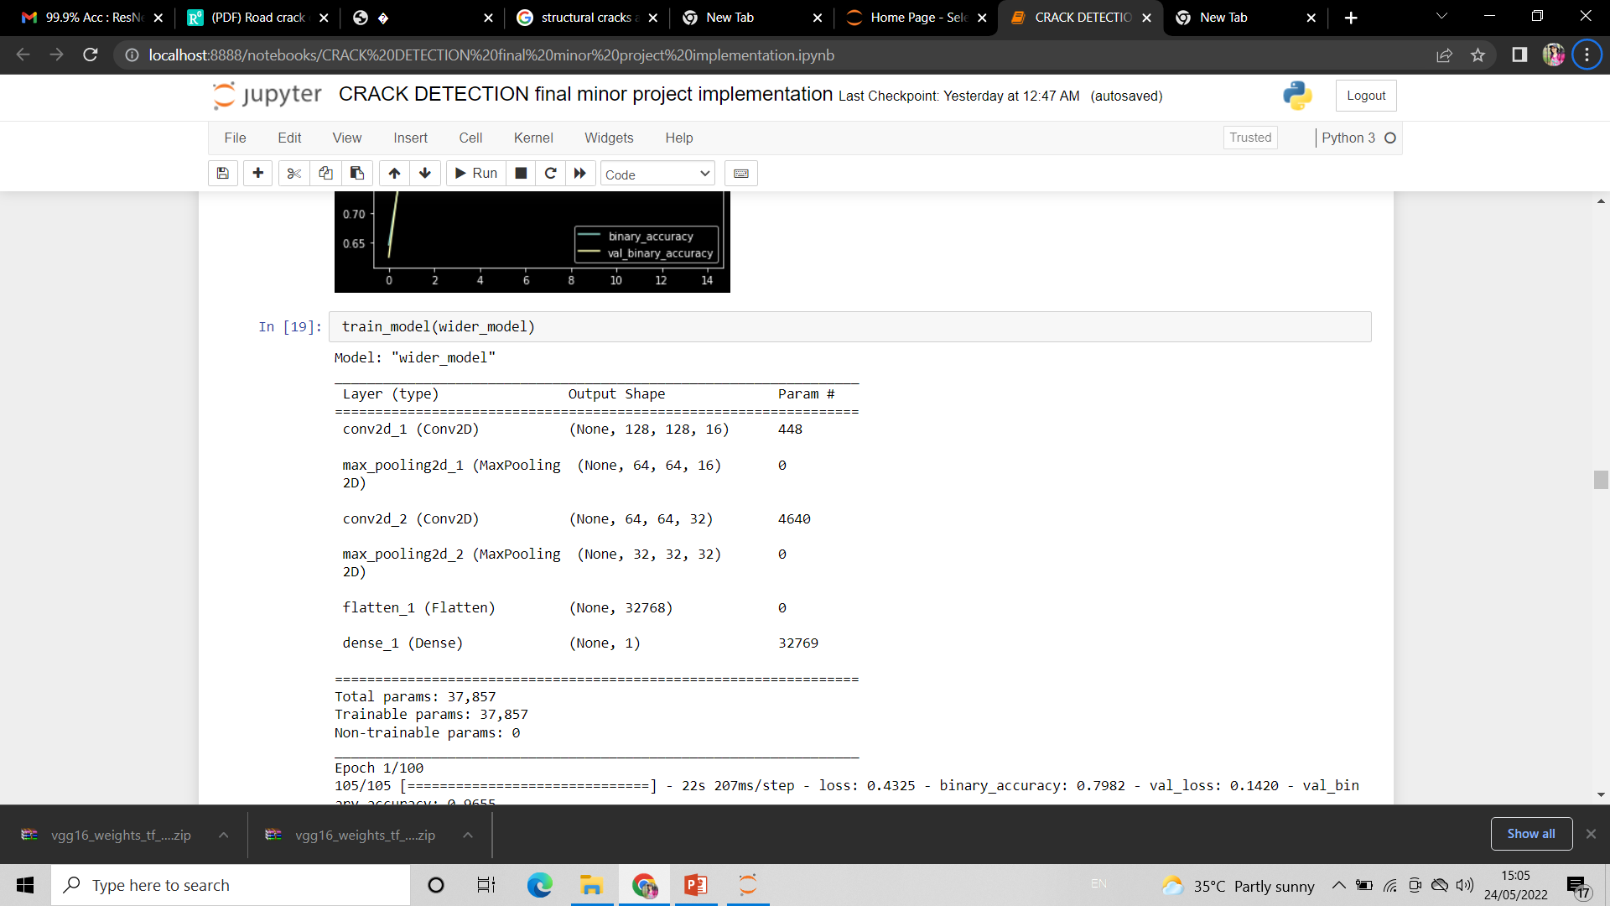
Wider model

Slide 20
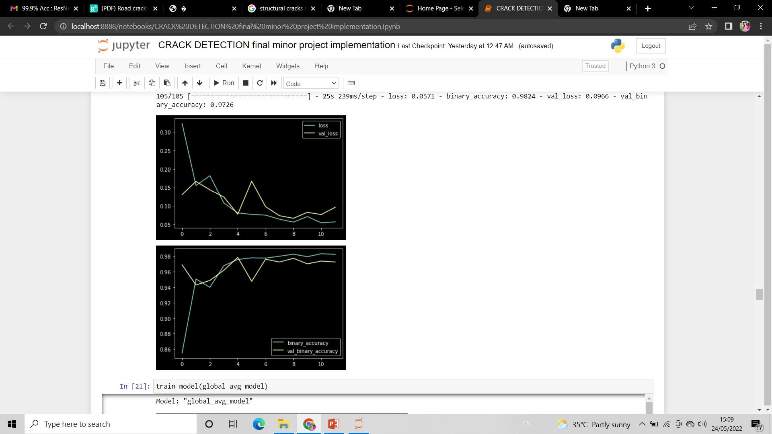
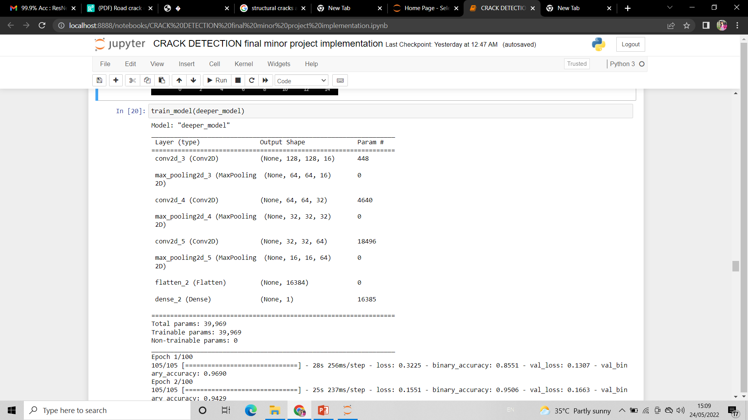
Deeper model

Slide 21
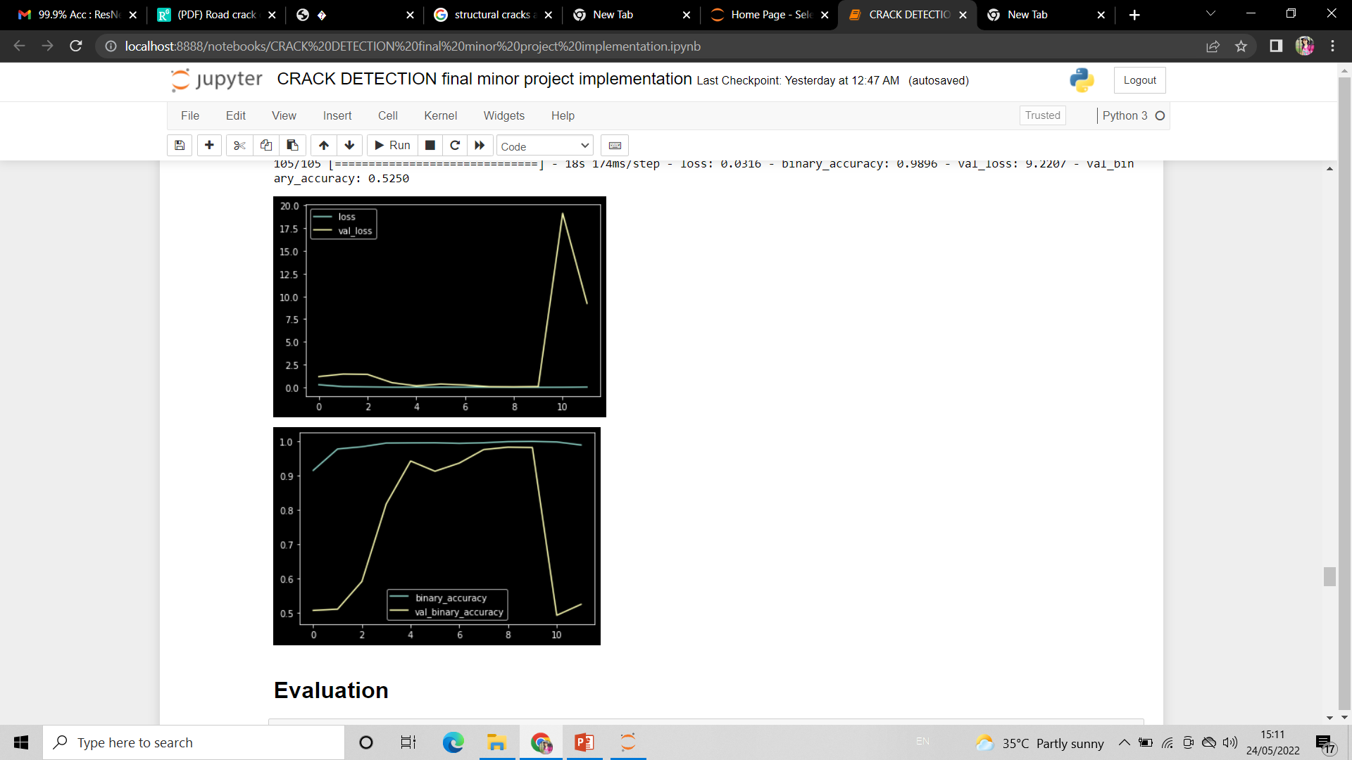
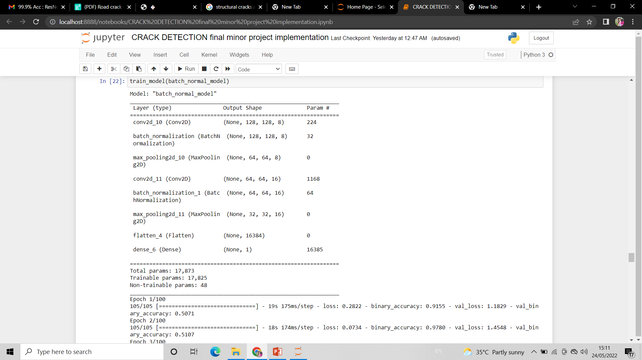
Using Bach_normal layer

Slide 22
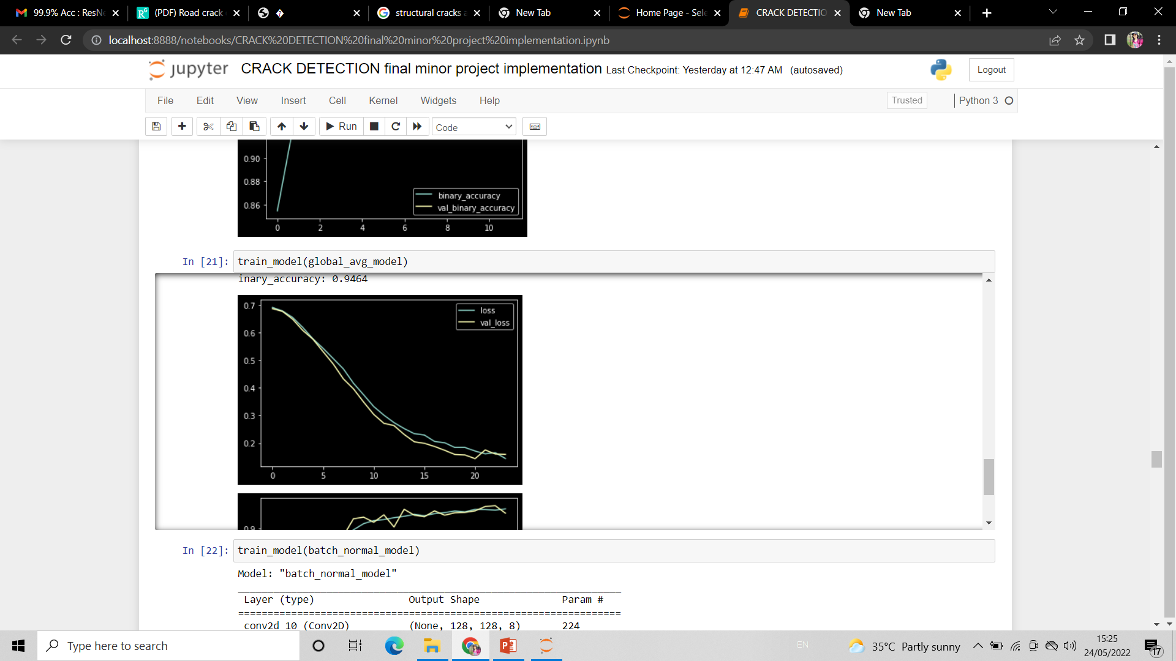
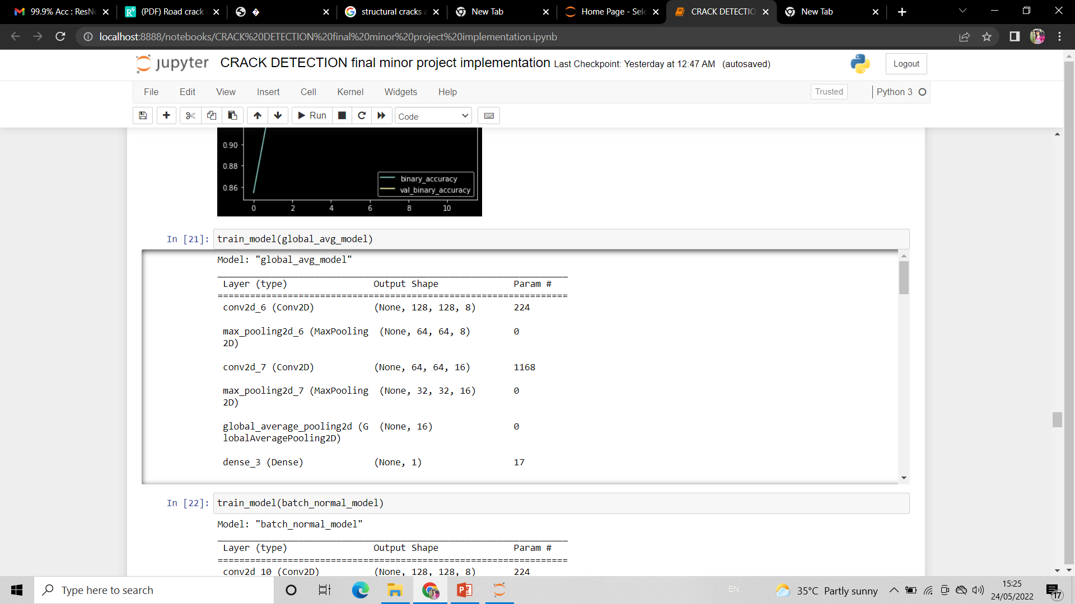
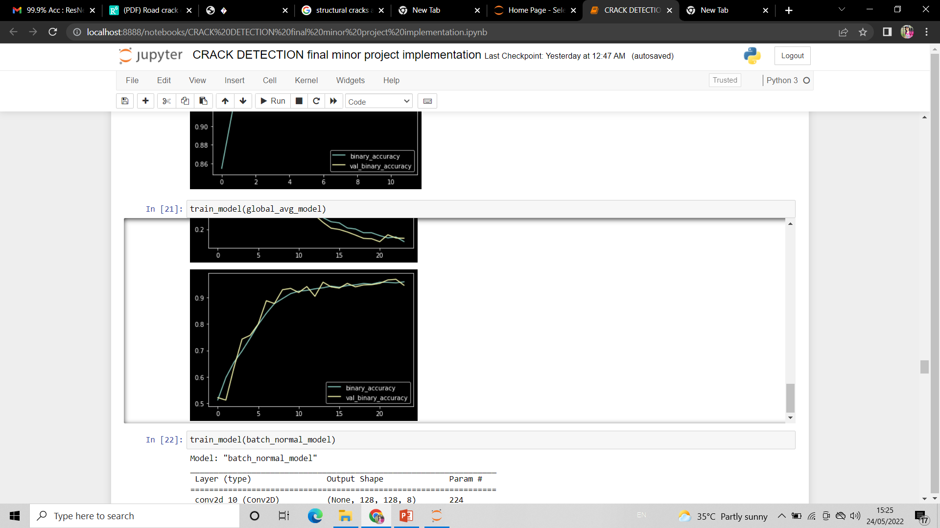
Using Global normalization layer

Slide 23
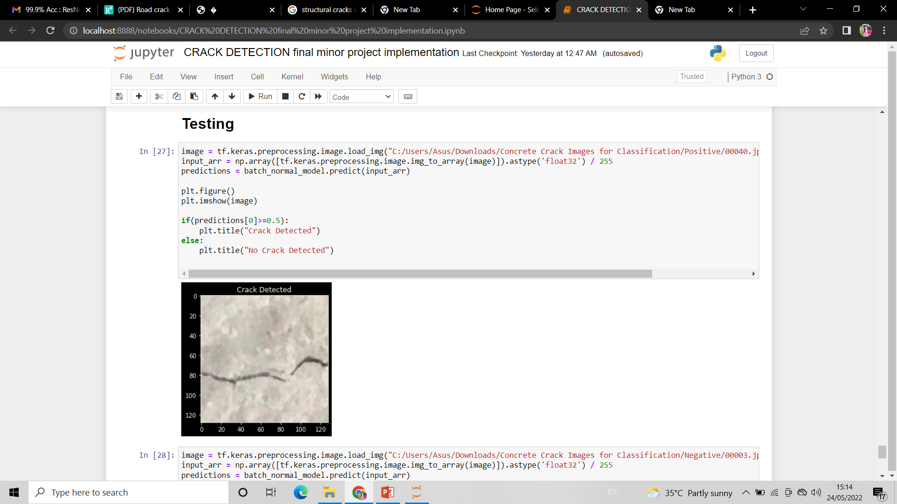
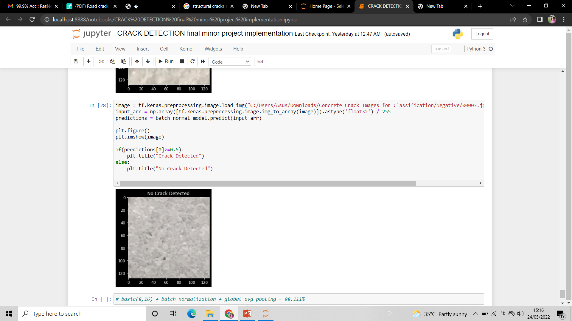
Testing

Slide 24
Results
The basic_model -> 96.722% accuracy.
The batch_normal_model ->98.333% accuracy.
A global_avg_model -> 96.556% accuracy.

Slide 25

Conclusion
In future work, an alternative strategy can be used. Different type of cracks can be detected and classified. Severity level of crack can be calculated. Also app can be developed and GUI can be created for easy navigation.
In this project, the cracks are detected in two classes by using image processing techniques.
Here, positive means crack is detected, whereas negative means no crack in image.

Slide 26
THANK YOU!

